Slide 1
Project Title Map-Blogs Using Secure Parallel Communication through Internet on Real-Time Operations
Guided by : Mr. P V Vinod
Scientist/Engineer
Organization : RRSC-South/ISRO Prepared by : Sravani Murakonda (N091869)
Computer Science andEngineering
University : RGUKT-Nuzvid

Slide 2
Agenda
ISRO & RRSC
Introduction
Scope
Existing System
Disadvantages
Proposed System
System Design
Advantages
Requirements
Implementations
Status Graph
Application
Future Work
Bhuvan 3D work

Slide 3
Indian Space Research Organization
ISRO was formed at August 15 1969 by Dr Vikram Sarabhai, who considered as Founding Father of ISRO.
The prime objective of ISRO is to develop space technology and its application to various national needs .
ISRO has Two major space systems they are
INSAT(Indian National Satalite) for communication and broadcasting
IRS(Indian Remote Sensing) for resource monitoring and management
Aryabhata is the first Indian satellite
On going Projects Chandrayan-II, Spacecraft to Moon, Adithya-I spacecraft to Sun.

Slide 4
Remote Sensing Center
NRSC Hyderabad
NRSC give data after preprocessing to RRSC
Five RRSCs South(Bangalore), East(Kolkata), North(Dehradun)), West(Jodhpur) and Central(Nagpur).
RRSC’s do data analyzing and data processing.
Acts as interface between space research center and society.
On going projects Road Asset Database Creation and GIS(Geographic Information System) updating, Updating 3D models of historical places in Bhuvan portal and Rainfall rate measurement.
Climate observations and finding Crop regions.

Slide 5
Introduction
Mapblogs is an interactive ,Internet-based ,mapping activity .
Mapblogs has two distinct views:
1 . The Blog View
2 . The Map View
In this project we are following The Blog View type Mapblogs .
Mapblogs is an efficient method to deliver content like multimedia files from a sender to a group of receivers by posting in the blog.
In this we are providng with Canvas board option and live data sending.

Slide 6
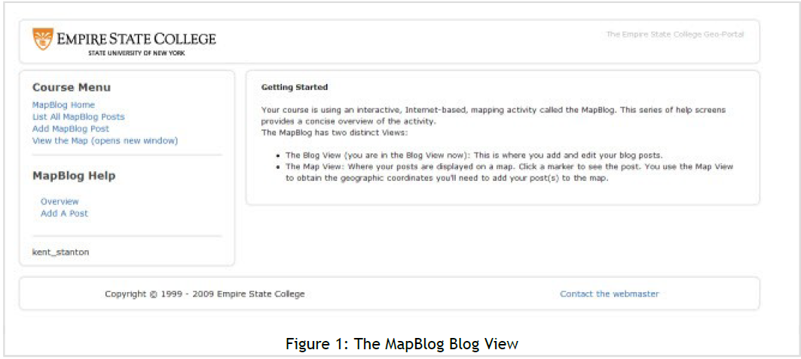

Slide 7
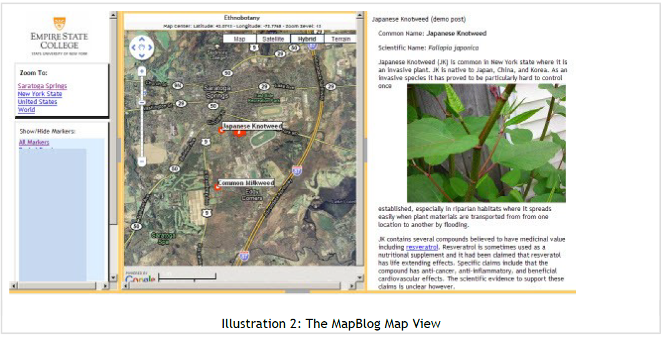

Slide 8
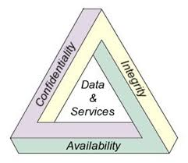
Cont…
File transferring securely .
For secure communication through internet the system should provide mainly three security services called CIA triad.
Mapblogs authentication provides the above three security services – data integrity, data origin authentication, Availability .

Slide 9
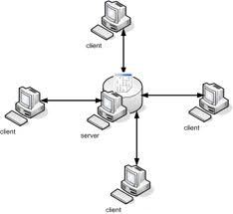
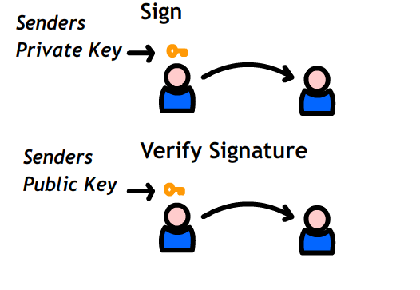
Contd..
The sender generates a signature for each packet with its private key which is called signing.
Each receiver checks the validity of the signature with the sender’s public key which is called verifying.
Internet
Internet
Internet
Internet

Slide 10
Scope
Providing security services to the data transfer in communication environment is the critical topic in present internet domain.
The application has been introducing with the real time applications
Secure authentication of client with server
Secure file sharing between clients
Live blogging with canvas technology
Live chatting

Slide 11
Existing System
The present system allows to post only existed files in this the users can’t create the new drawings.
Anyone can see the posts and intra blogging between selective people is not possible.
They are suitable for RSA which is expensive on signing while cheap on verifying. But, as per analysis report RSA had been cracked since it is running short of security parameters.
Correlation among packets make them vulnerable to packet loss.
Each block should be signed and verified independently.

Slide 12
Disadvantages
Existing System
overlook the heterogeneity of receivers
Lack Canvas board option and sending posts lively.
Lack of intra blogging among selective users
RSA is expensive on signing and as per analysis it is cracked

Slide 13
Proposed System
Intra blogging and canvas board chatting is available .
The basic scheme (Mapblogs) eliminates the correlation among packets and thus provides the perfect resilience to packet loss.
In this we are using an asymmetric encryption method i.e DSA.
It uses an efficient cryptographic primitive called batch signature which supports the authentication of any number of packets.
Server
Client A
Internet
Client B

Slide 14
System Design
Client A
Client B
Plain Text
Plain Text
No.of packets of data
Server
Integration of received packets
Packet data
Packet data
Private Key of A
Public Key of A
Digital signature assignment to packet
Verification of packet
Signed Packet
Signed Packet
Cipher Text
Cipher Text
Internet

Slide 15
Advantages
Proposed System
Authentication
Intra blogging and Canvasboard live posting
Prevention of packet loss due to correlation
Batch Signing of packets

Slide 16
Requirements
Hardware Requirements:
System : Pentium IV 2.4 GHz.
Hard Disk : 40 GB.
Floppy Drive : 1.44 Mb.
Monitor : 15 VGA Colour.
RAM : 256 Mb.
Real Time : Computers
Software Requirements:
Operating system : Windows XP or 7
Coding Language : Java, HTML
IDE : Eclipse JEE
GUI : Servlets, Jsp, Applets
Server :Apache Tomcat

Slide 17
Implementations
Work Done:
Worked for designing of 3D images of Mysore historical places using google sketch up software.
Done the secure transferring of files .
Secure authentication and secure live chatting.
To develop a secure live blogging with canvas board technology.

Slide 18
Status Graph
Status level
time

Slide 19
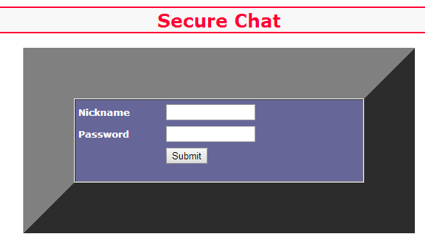
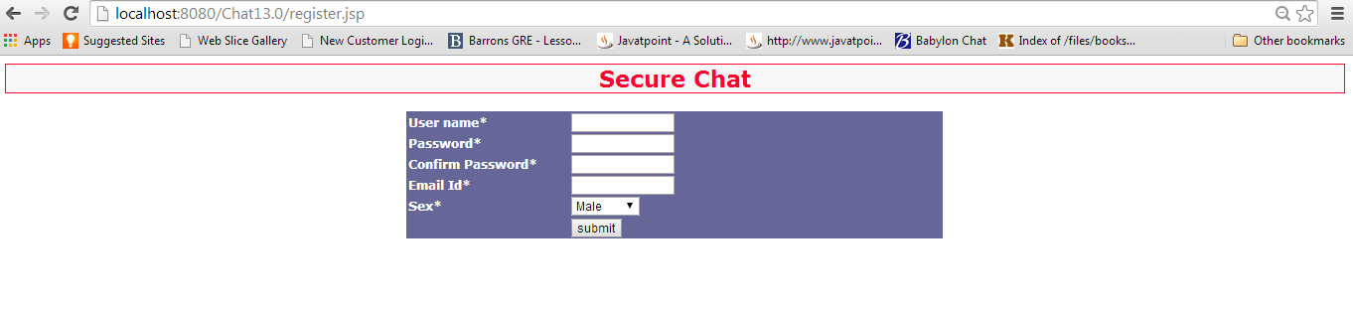
Application

Slide 20
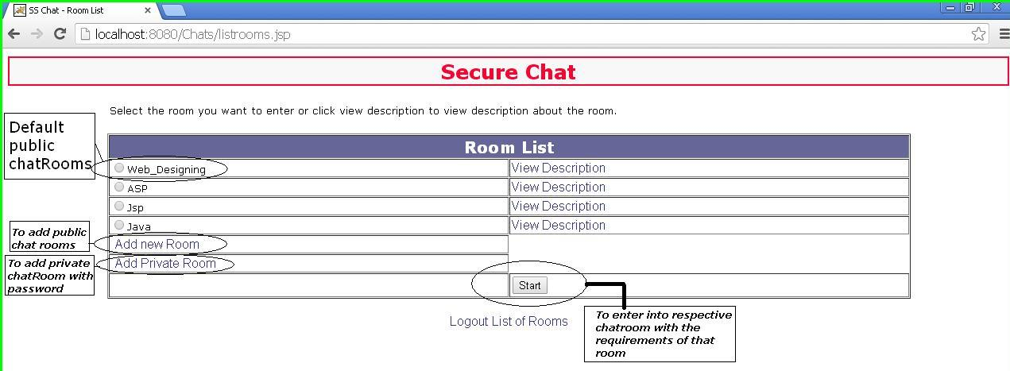

Slide 21
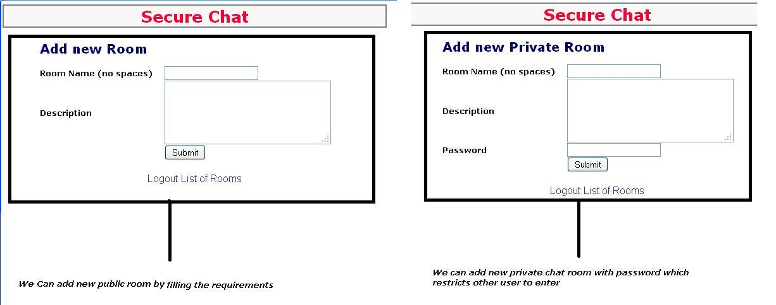

Slide 22
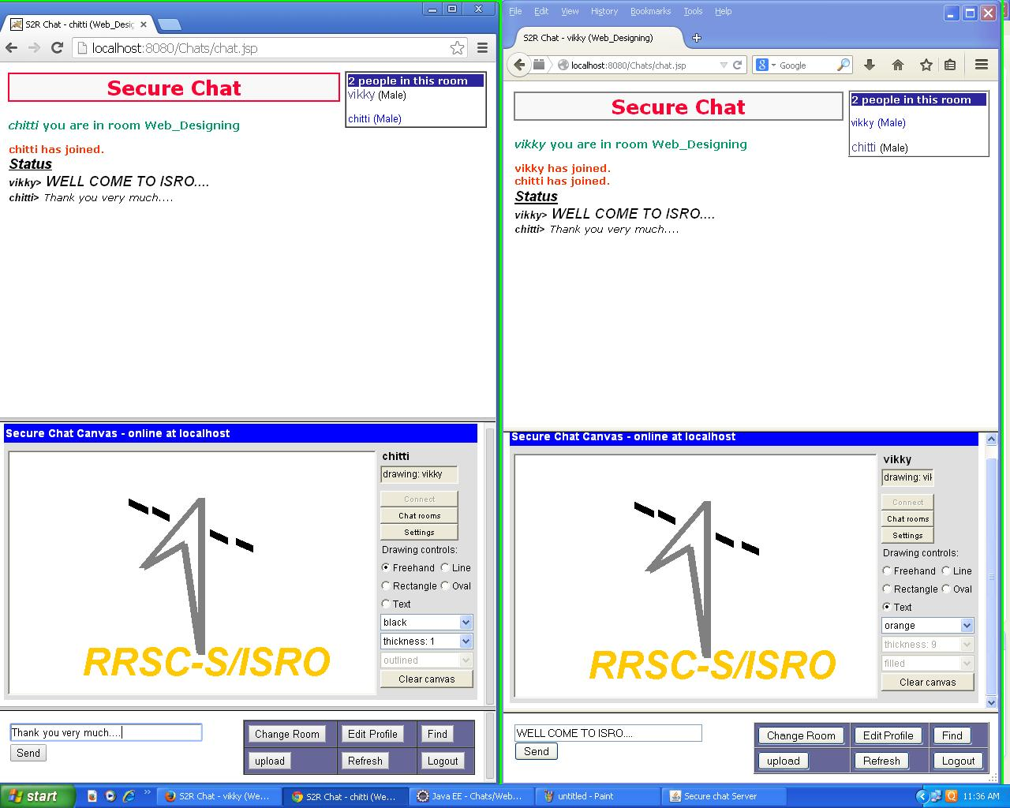

Slide 23
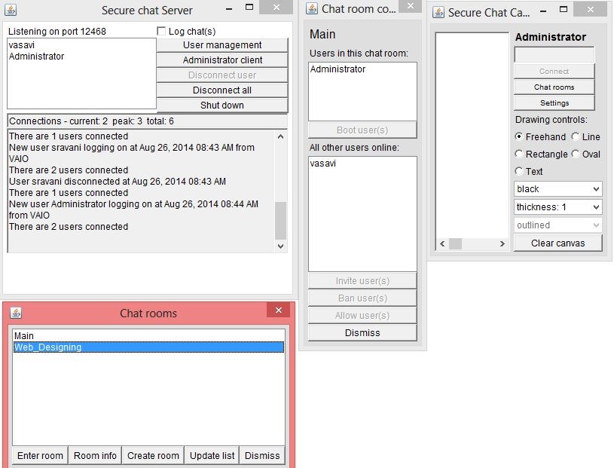

Slide 24
Future Work
Integrating current application with video conferencing.
Developing VoIP protocol for real time voice transmissions.
It can be used for monitoring the stock market.
It can be used for machine or architectural design.

Slide 25
Making of Three Dimensional Models of Historical Buildings Present in Mysore City Using SketchUp for Bhuvan
To capture the photographs of Historical buildings present in Mysore city.
To make 3D models of Historical buildings present in Mysore city Using SketchUp.
To import SketchUp model in to ArcScene.
Building Photographs
Photoshop
SketchUp
Google Earth Image
3D Model
ArcSene

Slide 26
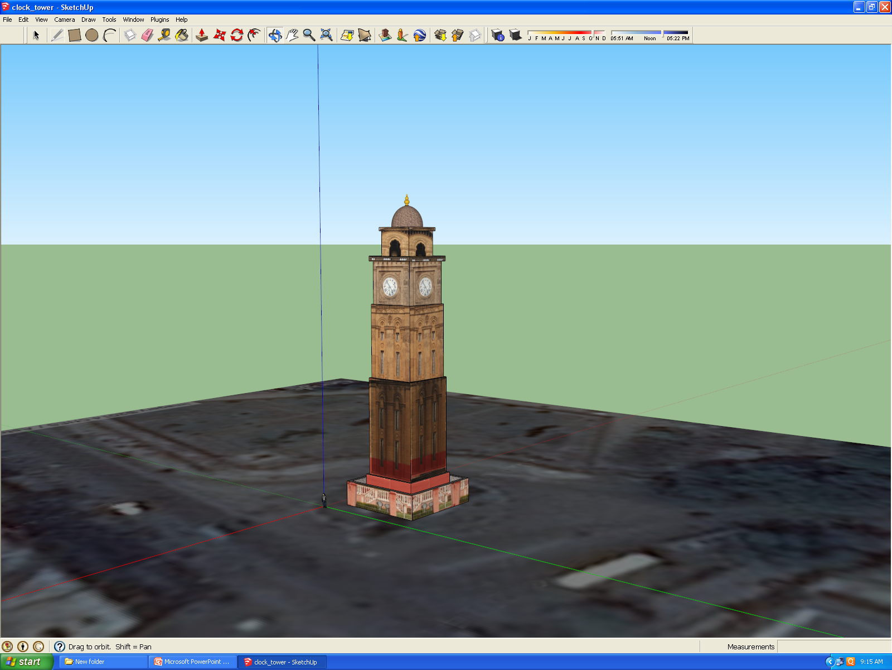
Clock Tower

Slide 27
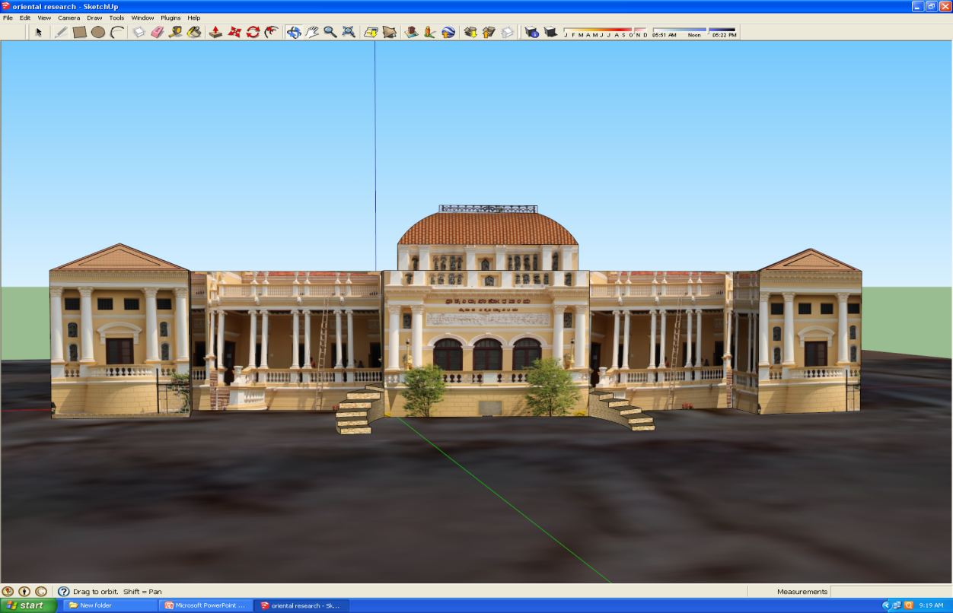
Oriental Research Building

Slide 28
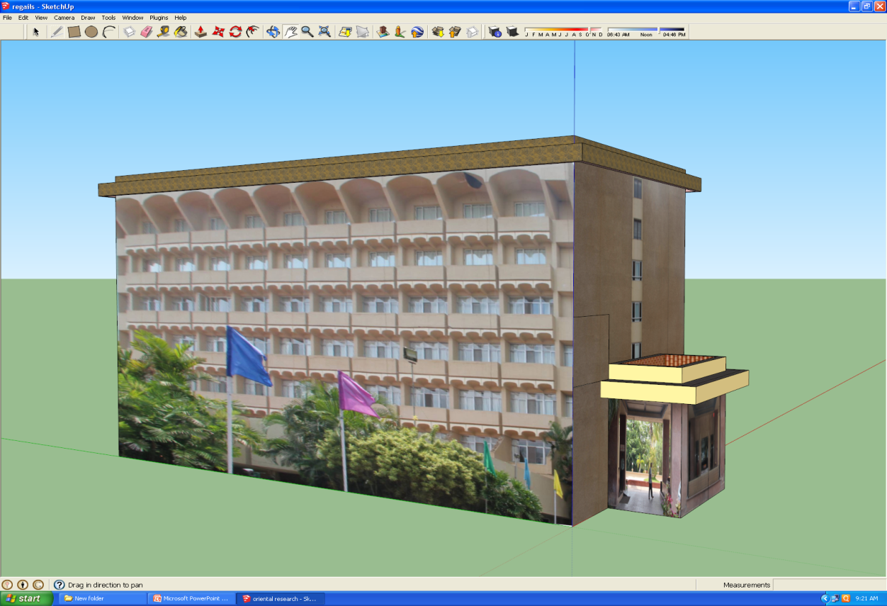
Regalis

Slide 29
Thank You

